Slide 1
Placement Portal
Sarthak Dubey(12-1-5-022)
Lokesh Kumar Meena(12-1-5-083)
Moumita Das(12-1-5-086)

Slide 2
Abstract
The Training and Placement cell of the college plays a vital for students for the purpose of proper placement of the aspiring students of the institute
It helps the students to provide their profiles to the training and placement cell of the institute
It helps to the students to know about the companies coming for the campus placement

Slide 3
Overview
The project is mainly intended for automating the procedure of placements.
The job of the project is to maintain the company details based on company requirements

Slide 4
Design Goals
It reduces the work pressure of the T/P cell staffs
Provide the statistics of the students placed.
Informing the students about the events going to take place
Easy retrieval of students data

Slide 5
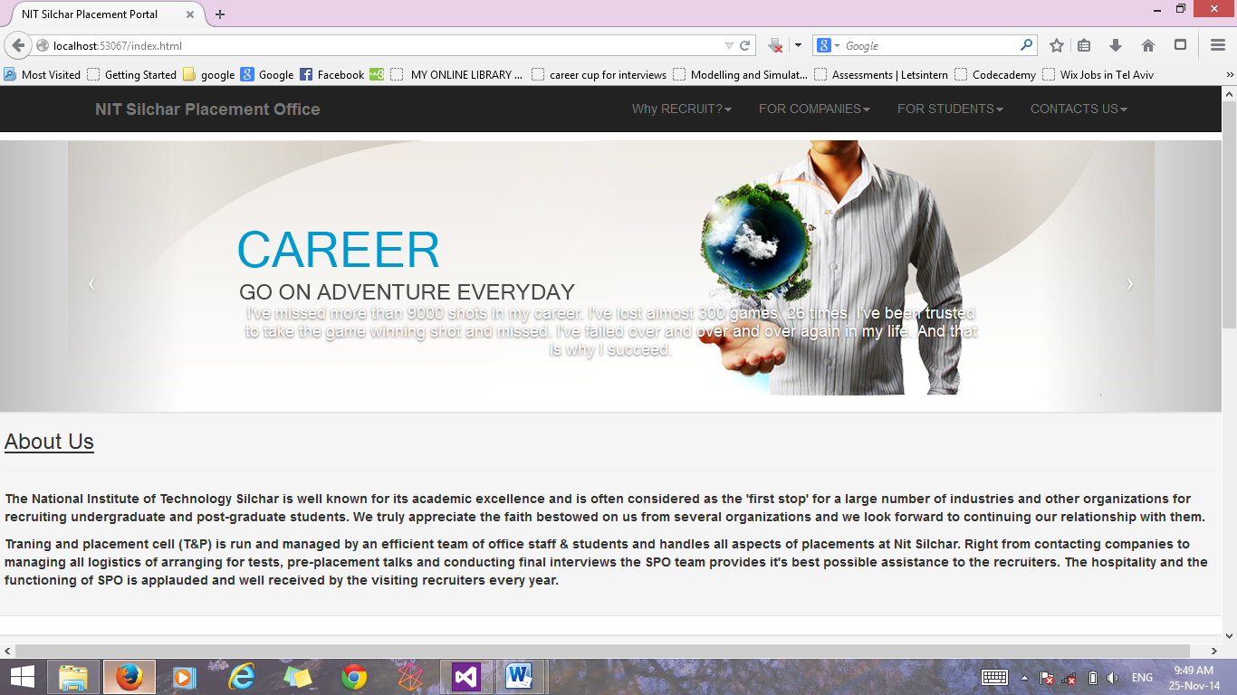
User Interface
Main Page

Slide 6
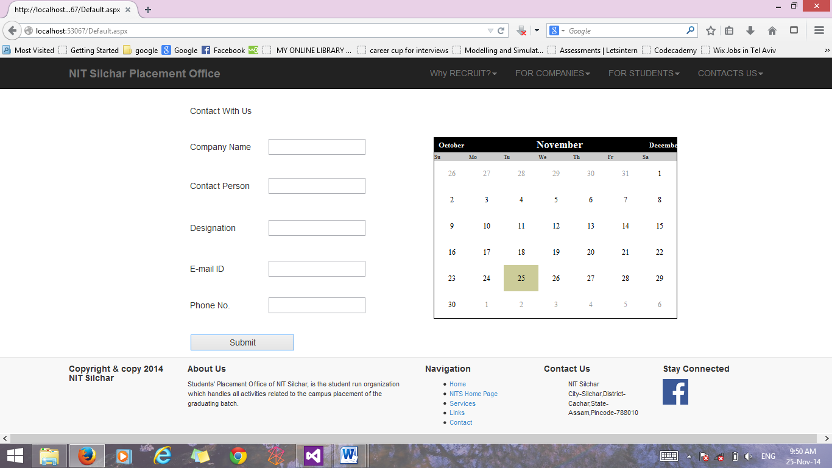
User Interface
Company Registration page

Slide 7
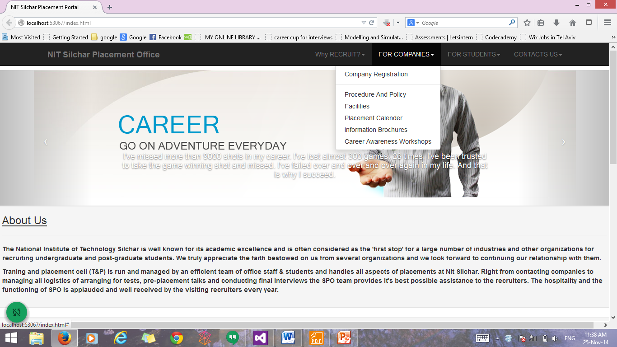
User Interface
Sections For Company

Slide 8
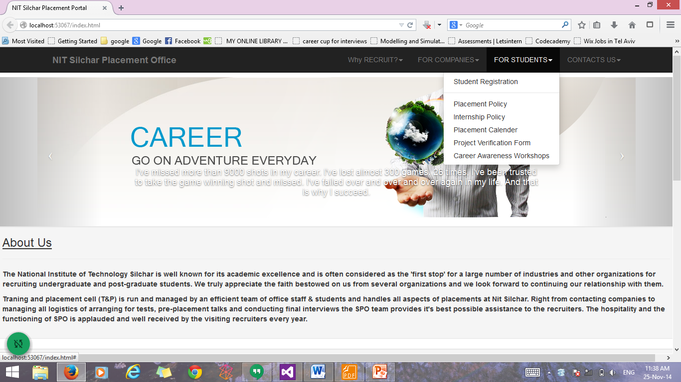
User Interface
Sections for students

Slide 9
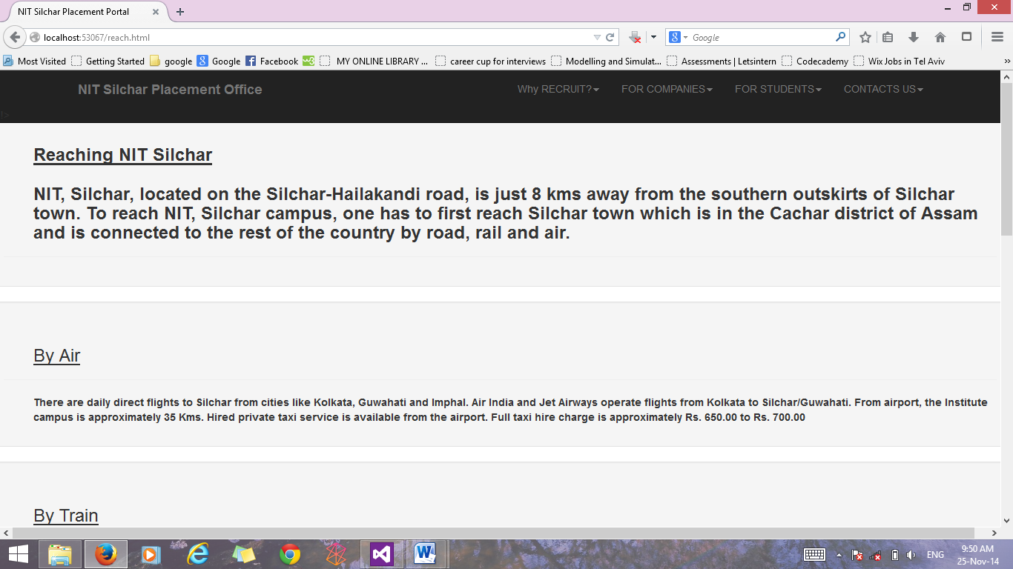
How To Reach Nit Silchar
Reaching Nit Silchar

Slide 10
Compatibility
Site Is adjustable For Any Device i.e Mobile ,Tablets ,desktop etc
Site Map is Not that Much complicated Easy to use

Slide 11
Thank You!!!!!!!

